Slide 1

Smart City Mobility Analytics & Intelligence Platform
Data-Driven Urban Mobility, Transit, Demand & Accessibility Analytics
Infosys Springboard Internship
Members detail:
Ashish
Akhil
Benhur
Khushi
Sowjanya

Slide 2




Project Overview
An end-to-end platform transforming fragmented urban mobility data into actionable intelligence — from raw data ingestion to decision-ready dashboards.
Data Integration
Mobility Analytics
Traffic, transit, weather, demographics, ride-hailing
Traffic flow, transit performance, geospatial patterns
Demand Intelligence
Accessibility & Decision Support
Forecasting, anomaly detection, trend analysis
Equity analysis, service gap identification, policy support

Slide 3

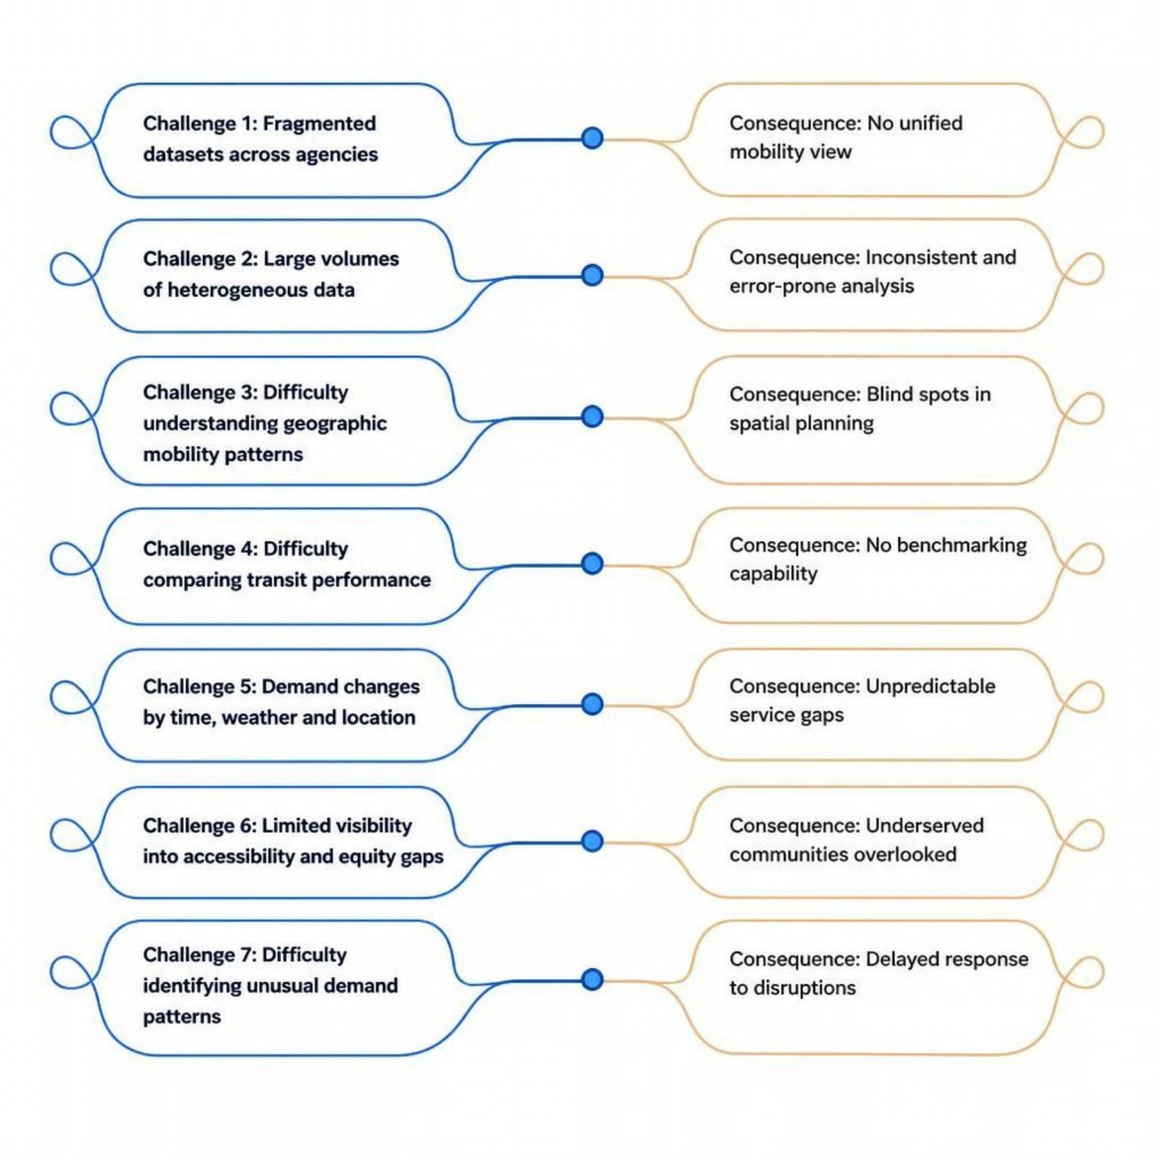
Problem Statement
Urban mobility data is siloed, inconsistent, and difficult to interpret — limiting evidence-based planning and equitable service delivery across cities.

Slide 4

Project Objectives
Integrate Mobility Datasets
1
Consolidate traffic, transit, weather, demographic, and ride-hailing data into a unified platform
Clean & Standardise Data
2
Transform raw, heterogeneous inputs into consistent, analysis-ready formats
Build Analytical Models
3
Design structured fact and dimension tables with a star-schema data model
Develop Mobility Intelligence
4
Create mobility, demand, and geospatial analytics with DAX measures and KPIs
Support Accessibility & Decisions
5
Enable equity analysis, anomaly detection, and data-driven decision support

Slide 5
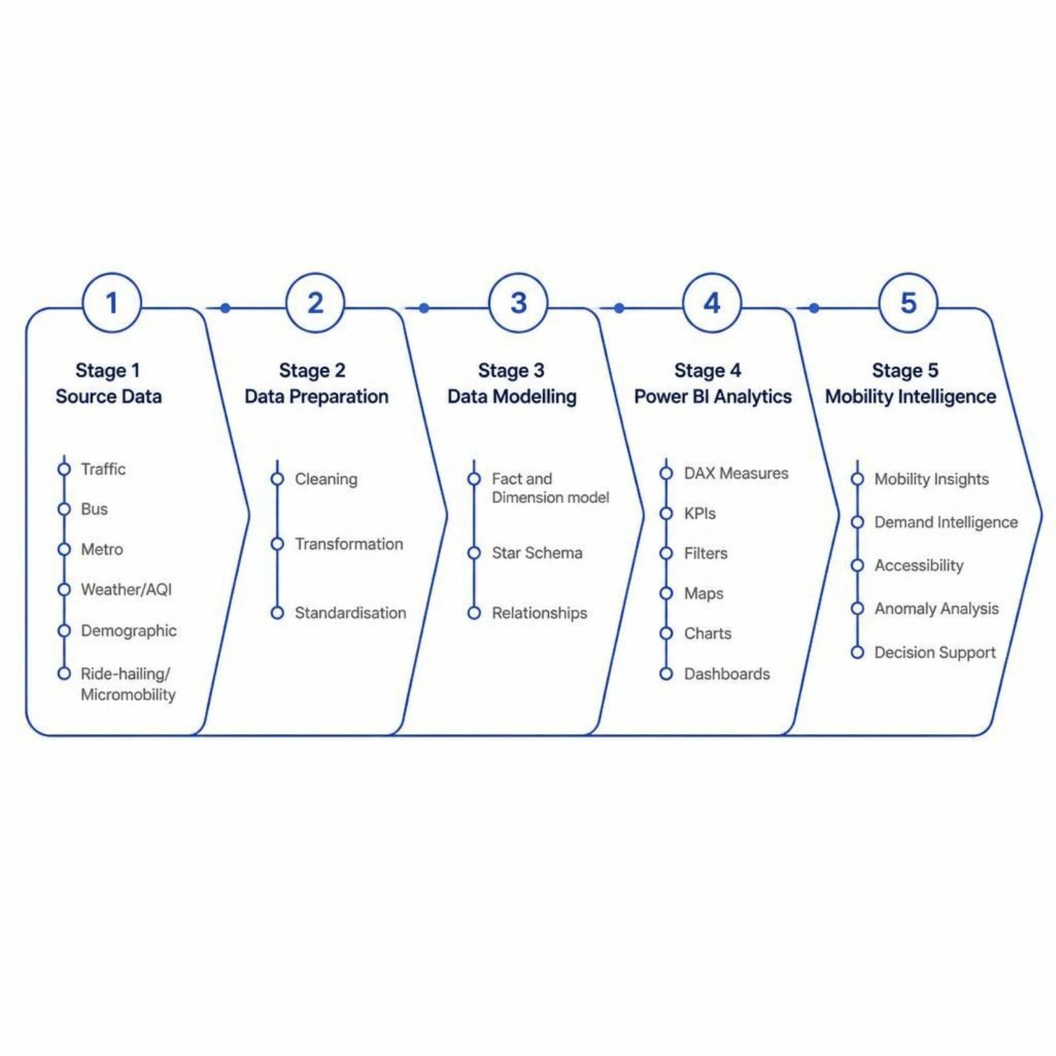
End-to-End Solution Architecture
The platform follows a five-stage pipeline — from raw source ingestion through preparation, modelling, analytics, and intelligence — ensuring every layer adds structure, consistency, and analytical value.

Slide 6

Data Acquisition, Integration & Preparation
Integrated and standardised traffic, metro, bus, weather/AQI, and demographic datasets for Power BI reporting.
  Consolidated multiple mobility data sources into a unified schema
  Standardised analytical fields for consistent reporting
  Organised data for structured, repeatable dashboards
Key Traffic Fields
Trip_ID · start_area · end_area · distance_km · time_of_day · day_of_week · weather_condition · traffic_density_level · road_type · average_speed_kmph

Slide 7
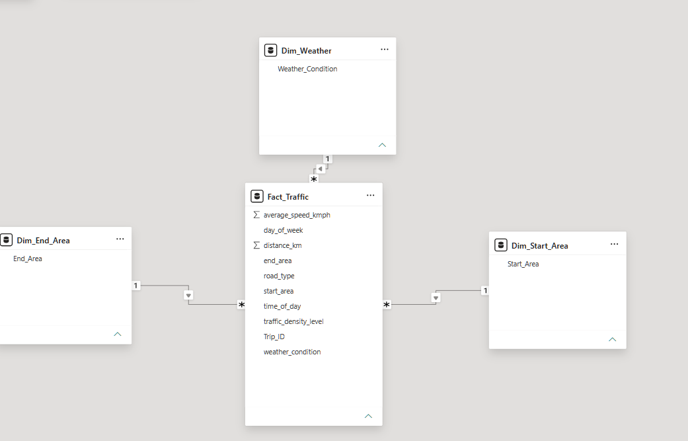
Star Schema & Data Model
The traffic-centric star schema organises trip-level mobility data around a central fact table, connected to supporting dimension tables for efficient querying and analysis.
Fact_Traffic
Dim_Weather
Dim_Start_Area
Dim_End_Area
Core trip records with measures
Weather and AQI attributes
Origin location details
Destination location details

Slide 8
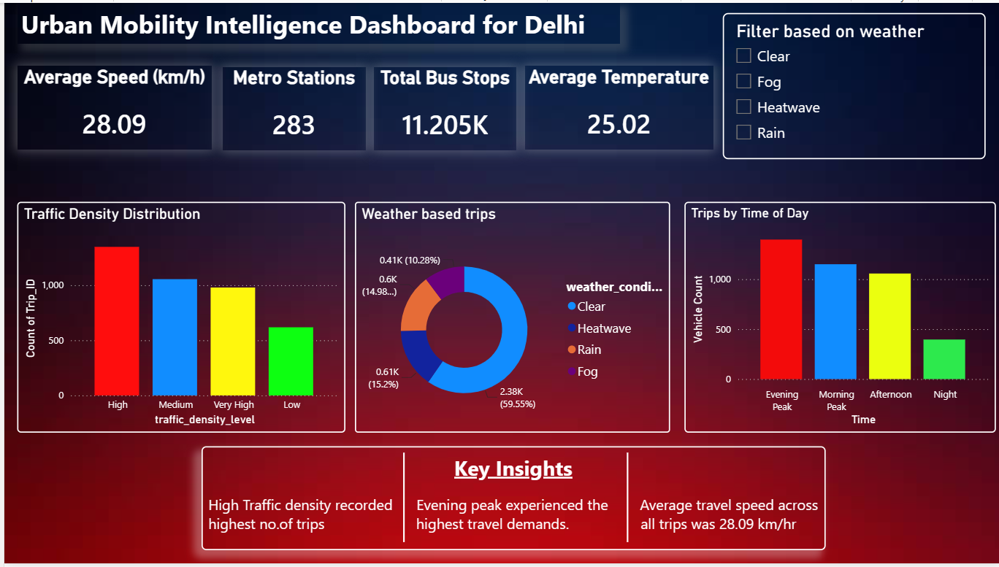
Urban Mobility Intelligence Dashboard
Speed & Density
Transit Coverage
Weather Impact
Weather-based trips and average temperature
Average speed and traffic density distribution
Metro stations and total bus stops
Time Patterns
Trip distribution by time of day with weather filtering

Slide 9
Milestone 2 — Geospatial & Transit Analytics
Geospatial Analytics
Transit Analytics
  Mobility demand heatmaps across India
  Delhi NCR origin–destination flow mapping
  City-based geographic filtering
  Passenger count by route
  On-time performance tracking
  Average speed & travel time analysis
  Weather-based travel analysis

Slide 10
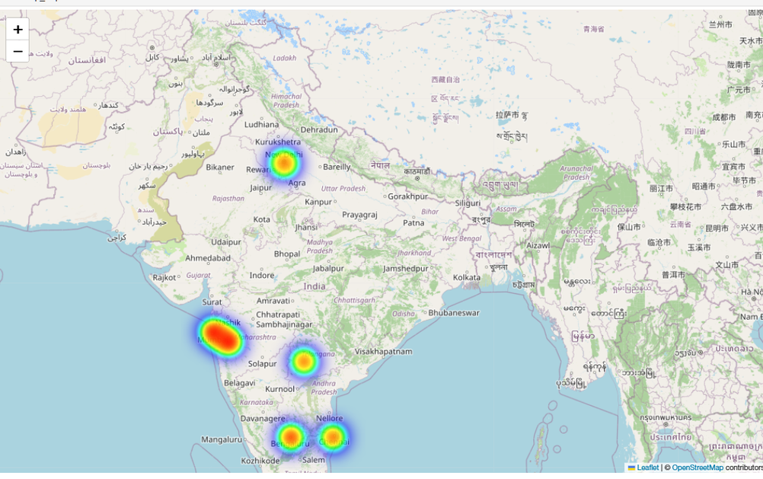
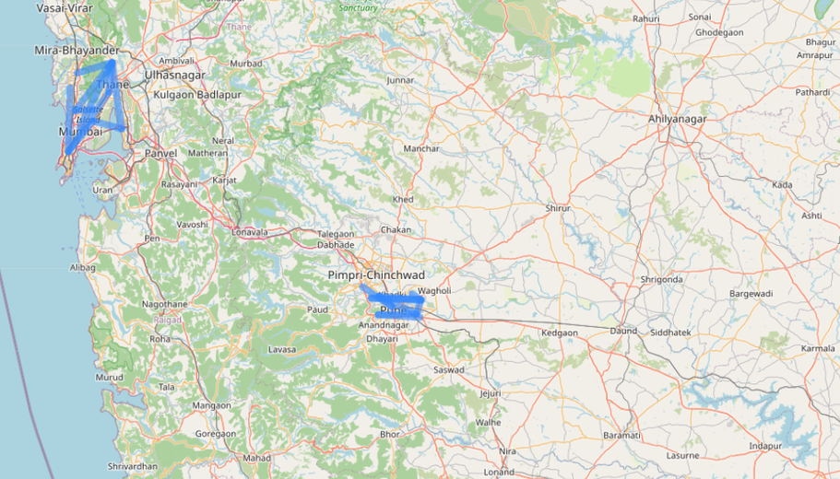
Geospatial & Route Performance Dashboards
Four Power BI dashboard views covering mobility heatmaps, flow mapping, route KPIs, and weather-influenced travel patterns.

Slide 11
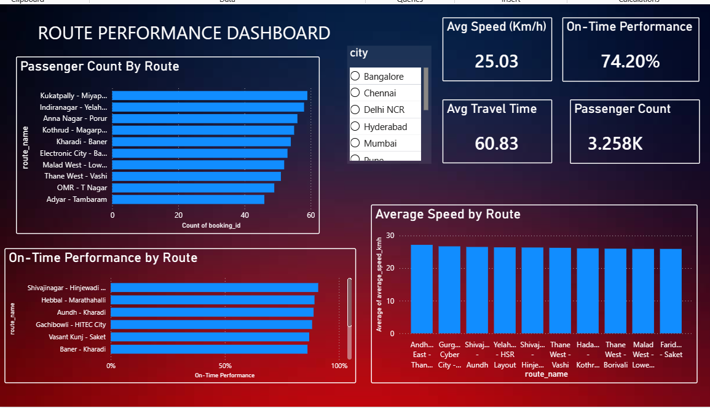
Geospatial & Route Performance Dashboards

Slide 12
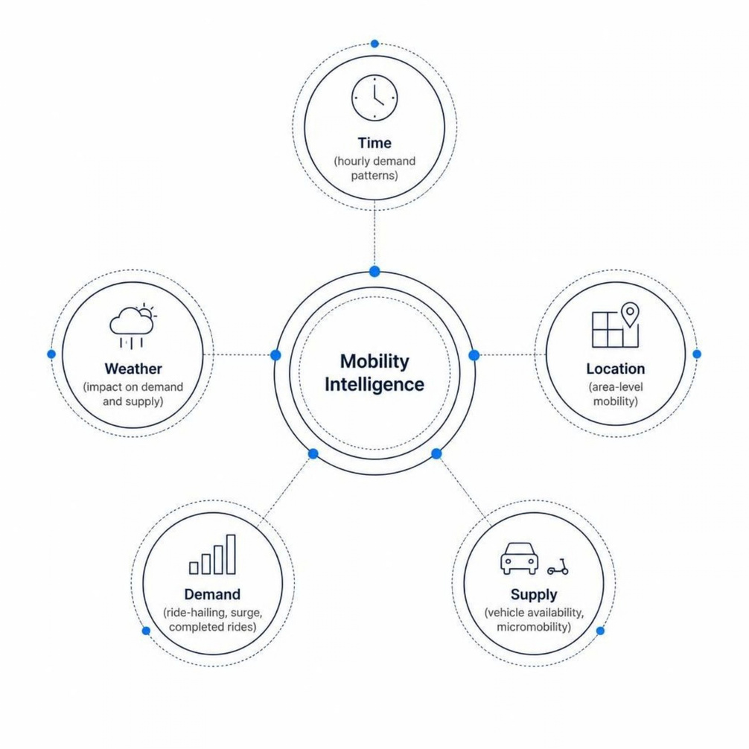
Milestone 3 — Demand Intelligence & Mobility Analytics
Key Dimensions Analyzed
  Ride-hailing demand & completed rides
  Surge patterns & wait time analysis
  Demand by hour & transport mode
  Vehicle availability & weather sensitivity
  Modal substitution & micromobility trends

Slide 13
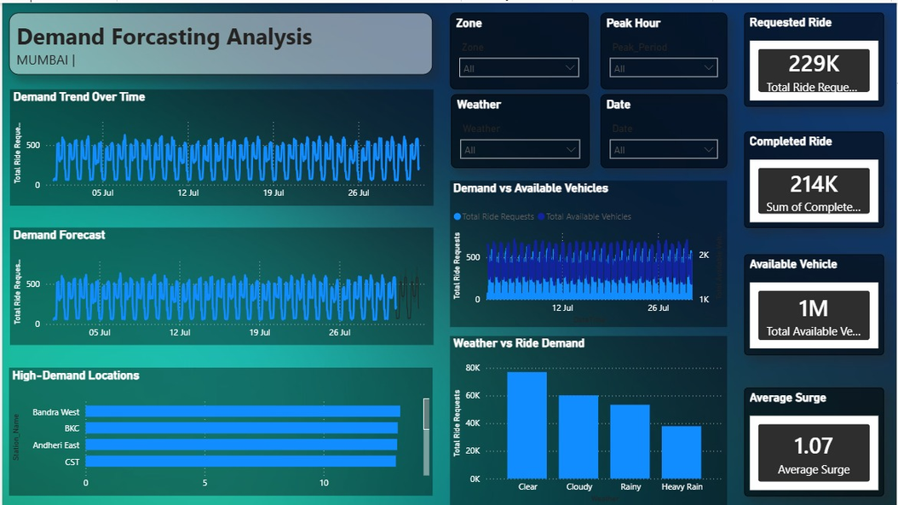
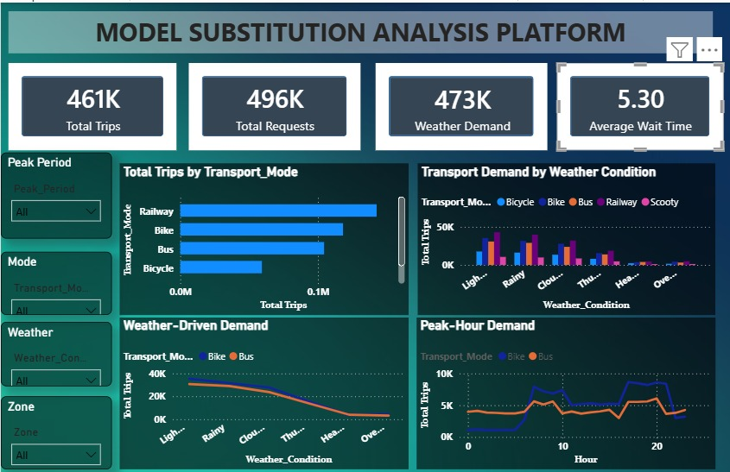
Work Done in Milestone 3

Slide 14

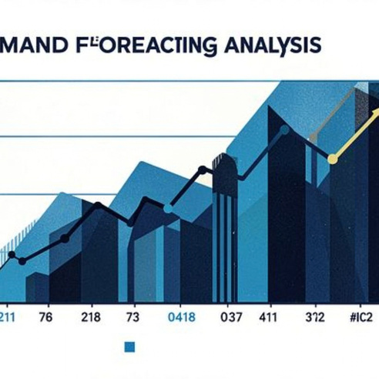


Forecasting, Ride-Hailing & Micromobility
  Demand Intelligence — ride-hailing demand, completed rides, and surge patterns by hour and location.
  Demand Forecasting — time-series projections identifying peak demand windows and supply gaps.
  Micromobility Analytics — usage trends across bike and scooter modes with modal substitution insights.
  Ride-Hailing Intelligence — vehicle availability, wait times, and weather sensitivity analysis.

Slide 15
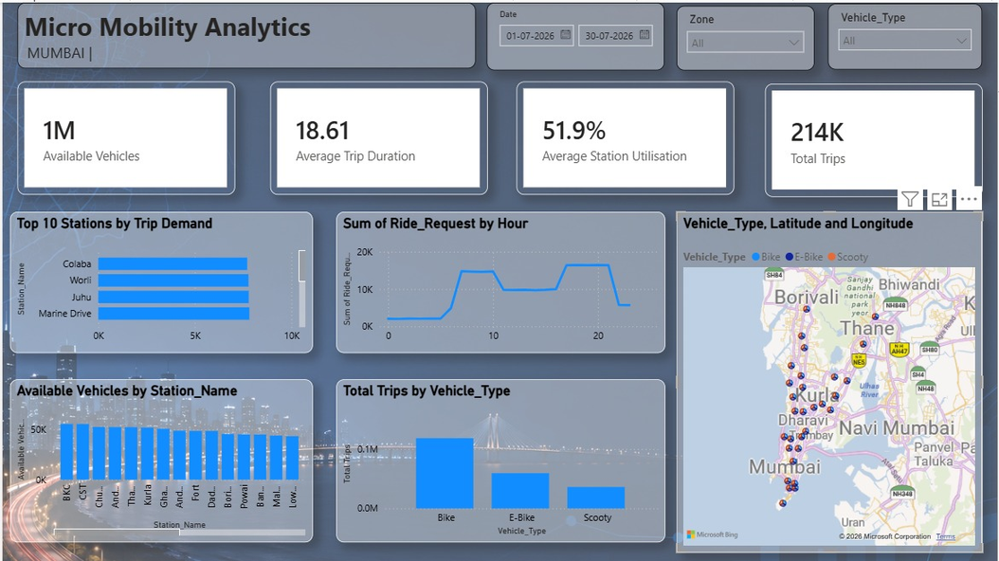
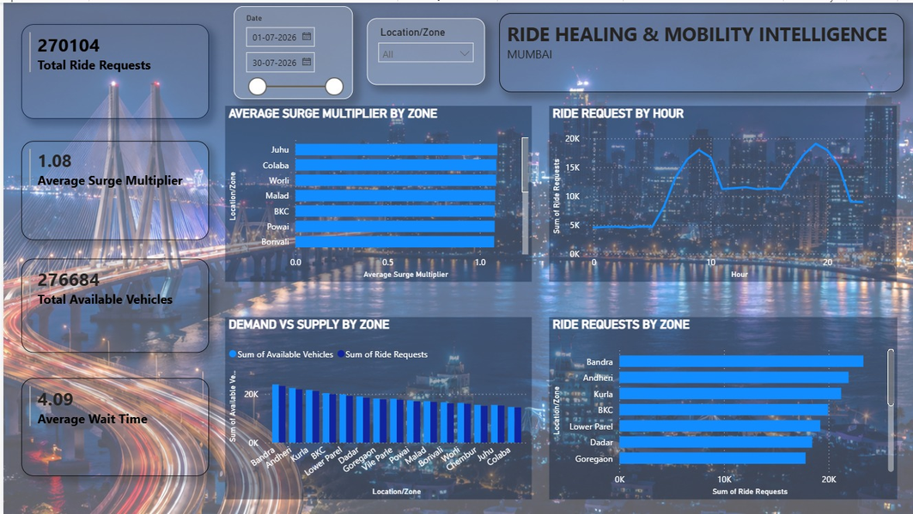
Work Done in Milestone 3

Slide 16
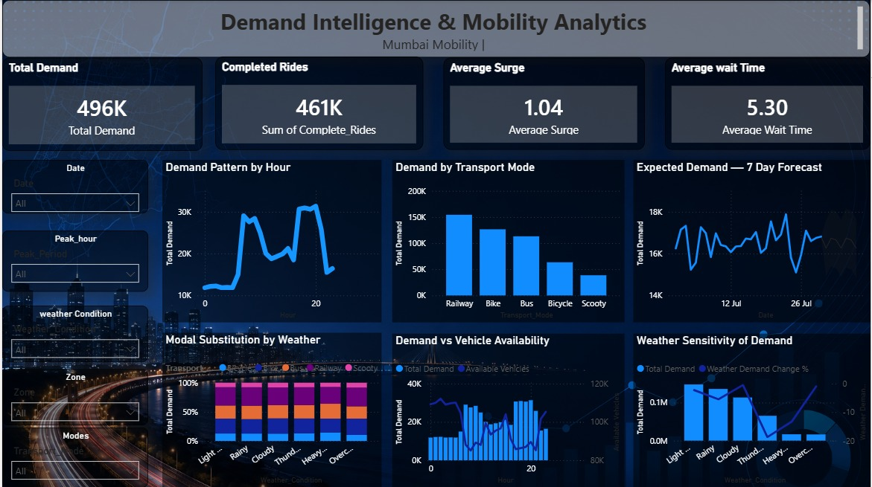
Final Dashboard created for milestone 3

Slide 17

Milestone 4 — Mobility Access & Equity
54.90
66.07
36.14
Mobility Access Index
Service Coverage
Avg Travel Time
Overall composite access score
Average coverage across zones
Minutes across transport modes
Dashboard Coverage
  Access by transport mode
  Top-access & bottom-access areas
  High-demand vs. low-coverage zones

Slide 18





Anomaly Detection & Decision Support
Diagnostic Framework
Observed Pattern
Demand, availability, delay, weather
Anomaly Detection
Actual vs. expected deviation
Area Diagnosis
Zone-level root cause
Decision Support
Low-coverage & night-time patterns

Slide 19

From Fragmented Data to Mobility Intelligence
Before
After
  Fragmented, disconnected datasets
  Limited geographic understanding
  Difficult demand interpretation
  Minimal visibility into accessibility
  No structured anomaly identification
  Integrated datasets with structured data model
  Interactive Power BI dashboards
  Geospatial & transit analytics
  Demand forecasting & supply analysis
  Accessibility scoring & anomaly-based decision support
Four milestones progressively transformed mobility data into an integrated analytical and decision-support workflow.

Slide 20
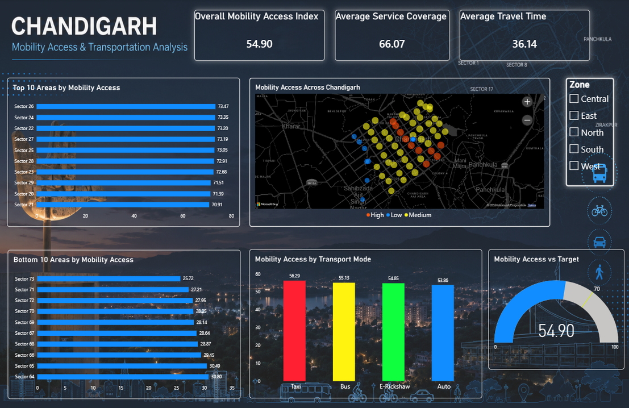
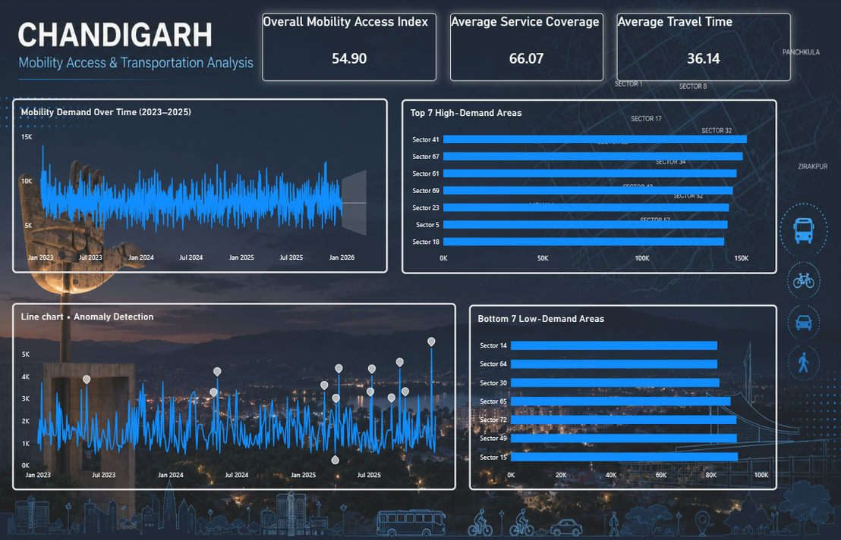
Work Done in Milestone 4

Slide 21
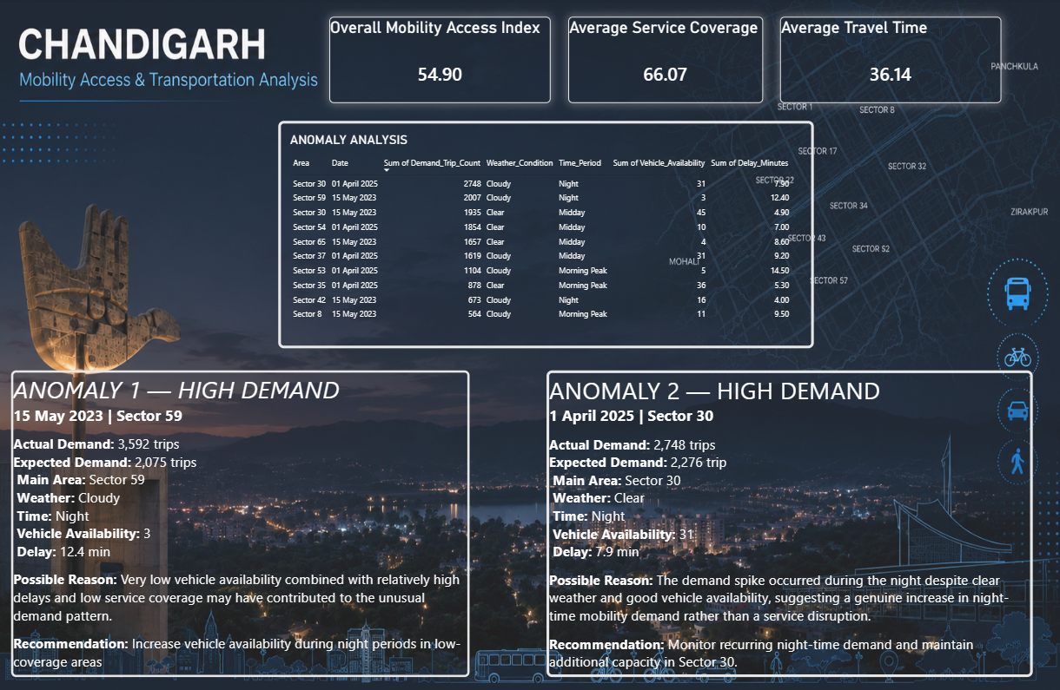
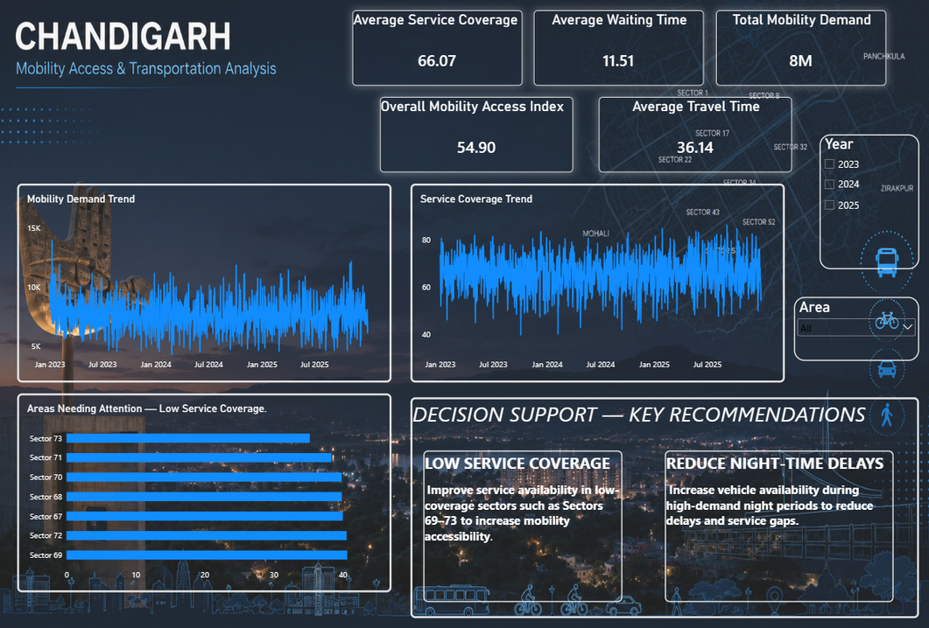
Work Done in Milestone 4

Slide 22
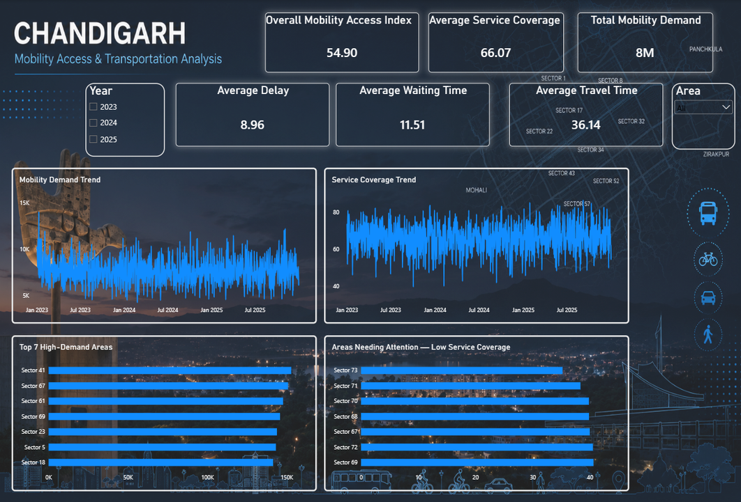
Final Dashboard
Platform Capabilities
  Mobility demand & service coverage
  Accessibility & demand trends
  High/low demand area identification
  Anomaly-based decision support
Future Scope
  Real-time data integration
  Advanced predictive analytics
  Automated monitoring & alerting
  Expanded forecasting models
  Broader geographic coverage
Key Learnings
  Data preparation & standardization
  Star-schema data modeling
  DAX & KPI development
  Geospatial visualization
  Demand, trend & accessibility analysis
  Anomaly-based decision support
Thank You

